Slide 1
Lesson objective
Title: Measurement and perimeter
Aim:
Be able to define perimeter
calculate the perimeter of common shapes
Plan:
- Converting units
Need calculators, whiteboards and rulers.

Slide 2
Converting measurement
How many mm in a cm?
How many cm in a m?
How many m in a km?
10
100
1000

Slide 3
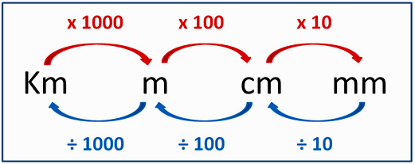



Unit Conversions
Sketch conversion chart into exercise books
Find the start and end units
Carry out the sum(s) on the arrows between the two units
LENGTH
500
$$5m= ………cm$$
Start with units you have, follow arrows to get to the unit you want
6
$$600cm= ………m$$
2.5
$$2500mm= ………m$$

Slide 4
Convert these to metres
Apply
300cm
= 3m
0.6km
= 600m
0.073km
= 73m
700cm
= 7m
0.33km
= 330m
654cm
= 6.54m
800cm
= 8m
153cm
= 1.53m
3250mm
= 3.25m
250cm
= 2.5m
1000mm
= 1m
2.04km
= 2040m
180cm
2200mm
= 2.2m
50300mm
= 1.8m
= 50.3m

Slide 5
What do I need to do to….
Convert 5m into cm?
Convert 7km into m?
Convert 145cm into m?
Convert 80mm to cm?
Times 5 by 100
Times 7 by 1000
Divide 145 by 100
Divide 80 by 10

Slide 6
The perimeter is:
Teacher read aloud in red
Students read aloud after counted in.
Random draw to read next and fill in blank
The total length forming the boundary of a closed geometrical figure.
The ____ length forming the boundary of a closed geometrical figure.
The ____ length forming the ________ of a closed geometrical figure.
What is the line forming a boundary of a shape called?

Slide 7
White boards
What is the perimeter of the following shapes:
5m
12mm
3m
3m
6cm
6cm
20mm
20mm
5m
8cm
12mm
To get the perimeter we must ADD all the sides together of the shape

Slide 8
Challenge
8m
Answer = 26m
Perimeter is the total length forming the boundary of the shape.
5m

Slide 9
Perimeter activity
Copy the table in your exercise book
Measure each object’s perimeter
Find 3 more objects and work out their perimeter
OBJECT | Perimeter
Your desk
Your exercise book
Teachers desk
A white board
1.
2.
3.

Slide 10
Reflection
What is perimeter?
Can you work out the perimeter of this classroom?
Lets do it!

